Slide 1
Making this resource work for you
Prior to teaching this lesson, please refer to the ‘Unit Overview and Planning Document’.
Further guidance on planning Science Mastery lessons can be found in the detailed planning guidance document.
Refer to the ‘notes’ section on each slide for useful information, including suggested expositions, pedagogical content knowledge, suggested questions, answers and more. Consider using presenter mode so you can see this guidance throughout the lesson.
The introduction slides can be adapted to suit your teaching style and the needs of your class.
Before the lesson, adapt the fix-it slide to address any misconceptions identified in the previous lesson’s exit ticket.
Choose from the suggested activities to suit your class. The intention is not that you complete all of these, but that you select those which ones are most appropriate for your students. It may be appropriate to further adapt activities for your students.
These lessons are designed to occupy approximately 1 hour. To adapt for a shorter or longer lesson duration we advise you to adapt the activity section accordingly.
Please consider using the final slide to send feedback about this lesson or examples of PowerPoints that you have adapted to our design team. Your feedback is used to improve Science Mastery for all of our teachers and students. We appreciate all suggestions and comments.
Thank you for reading!
The Science Mastery Team

Slide 2

Polymers
Answer the questions below.
Define a hydrocarbon.
Name the type of bonding found in hydrocarbons.
State the general formula of the alkanes.
Describe how fractional distillation is used to separate crude oil.
Explain the difference between reusing and recycling.
A compound that contains carbon and hydrogen atoms only.
Covalent
C_{n}H_{2n+2}
Crude oil is heated and hydrocarbons are evaporated. Then condense at different temperatures depending on their boiling points.
Reusing involves using the same product again, but recycling involves a process of making the materials from the product into something else.
Notes:
Big idea: Reactions rearrange matter
Foundation: State the formula of the smallest alkane.
Stretch: Explain why the alkanes are described as saturated.
Answers:
Foundation: CH₄
Stretch: They contain only single (C-C) bonds.

Slide 3
Polymers
Do Now:
Define a hydrocarbon.
Name the type of bonding found in hydrocarbons.
State the general formula of the alkanes.
Describe how fractional distillation is used to separate crude oil.
Explain the difference between reusing and recycling.
Drill:
Describe the structure of diamond.
Describe the structure of graphite.
Explain why graphite conducts electricity but diamond does not.
Notes:
Drill answers:
In diamond, each carbon atom is covalently bonded to four other carbon atoms in a giant covalent network.
In graphite, each carbon atom is covalently bonded to three other carbon atoms in a giant covalent network, and arranged in layers, leaving a free electron from each carbon atom.
Graphite contains free electrons to carry the charge through the structure, but diamond does not.

Slide 4
Polymers
Read Now:
The word polymer comes from Greek and means ‘many parts’. A polymer isa very long molecule made up of many units. Polymers can be naturally occurring or synthetic (man-made) and we use many examples in our daily lives. One of the most important naturally occurring polymers is DNA, which is found in the nuclei of all our cells. Other naturally occurring polymers are proteins and starch. These naturally occurring polymers make up an important part of our diet, but they must be digested into small soluble products before being absorbed into our blood stream. Products made from synthetic polymers are all around us, including plastic products, silicone products, nylon and polyester clothing.
Define a polymer.
Define synthetic.
Give three examples of naturally occurring polymers.
Explain why naturally occurring polymers found in foods must be digested.
Give an example of a synthetic polymer.

Slide 5
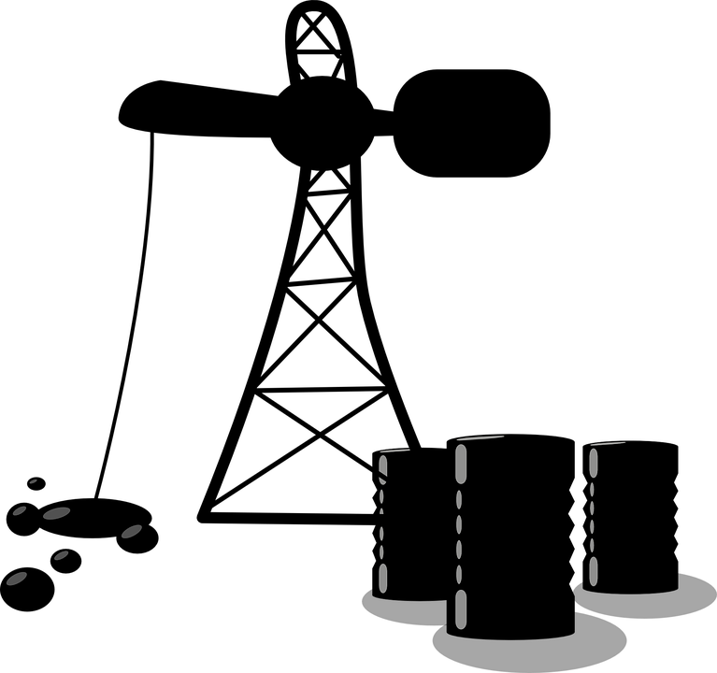
C5.1.12
13/09/2024
Polymers
C5.1.1 Prior Knowledge Review
C5.1.2 Crude Oil and Hydrocarbons
C5.1.3 Fractional Distillation
C5.1.4 Combustion of Hydrocarbons
C5.1.5 Cracking
C5.1.6 Taking it Further: Alkenes
C5.1.7 Taking it Further: Alcohols
C5.1.8 Taking it Further: Producing Ethanol by Fermentation
C5.1.9 Taking it Further: Producing Ethanol from Ethene
C5.1.10 Taking it Further: Carboxylic Acids
C5.1.11 Taking it Further: Esters
C5.1.12 Polymers
C5.1.13 Taking it Further: Addition Polymerisation
C5.1.14 Taking it Further: Condensation Polymerisation
C5.1.15 Taking it Further: Naturally Occurring Polymers
Notes:
Big Idea: Structure Determines Properties
In this lesson, which is for both combined and separate science students, students review the key content of polymers from C4.1 Structure and Bonding. The focus will be on relating structure to properties. Addition polymerisation will follow in the next lesson, as this is not required for combined science students.
This lesson also contains the Chemistry only content of thermosetting vs thermosoftening polymers.
Suggested Hook:
Using paperclips joined to make a paperclip chain, it can be useful to introduce/review the key terms of monomer and polymer.

Slide 6

Following this lesson, students will be able to:
Define a polymer
Chemistry only: Explain the difference between thermosoftening and thermosetting polymers
Chemistry only: Explain how the properties of a polymer make it suited to a function
Key Words:
polymer
monomer
thermosoftening
thermosetting
crosslinks
Notes:
Guidance:
See unit overview document and planning guidance to see how these objectives are typically assessed at GCSE, including examples of what students should be able to do following this lesson.
Planning for different needs:
The learning objectives given on this slide are suggested based on the most common requirements for exams, however they can be adapted based on the needs of different classes.
For best practice, the unit preparation booklet should be used to determine the appropriate focus of lessons within the unit.
While it is not possible to explicitly split content into levelled grades, we recommend that lesson objectives can be classified as critical, core or stretch.
Critical: the content or skill is essential for all students to be able to progress.
Core: the content or skill is important for students to progress, but other opportunities may be available to revisit it.
Stretch: the content or skill may not be essential for all students but is important for students aiming for the highest grades.
Key skill: this is a crucial skill being developed in this unit as part of the skill mapping
C5.1.12 Lesson Objectives:
Critical: Define a polymer
Core: Explain the difference between thermosoftening and thermosetting polymers
Core: Explain how the properties of a polymer make it suited to a function

Slide 7
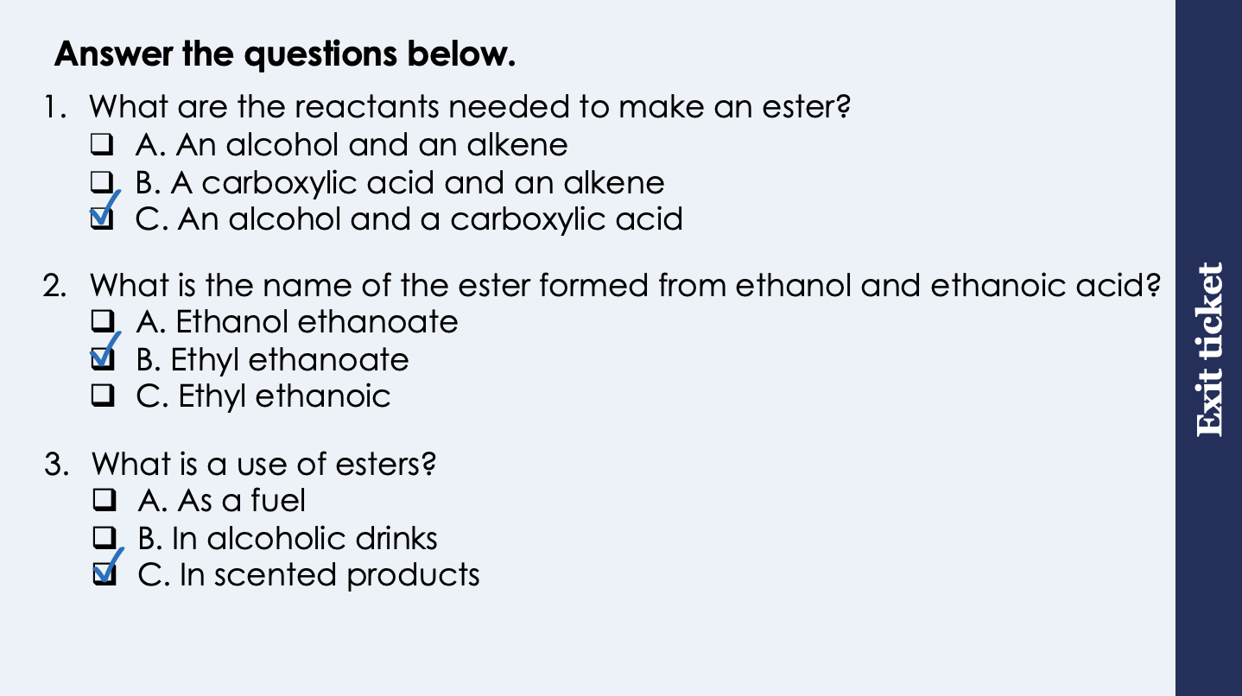
This is the fix-it portion of the lesson
The fix-it is an opportunity to respond to gaps in knowledge, especially those identified by the pre-unit quiz.
The teacher should customise this slide as needed, to facilitate
reteach, explanation, demonstration or modelling of ideas and concepts that students have not yet grasped or have misunderstood.
practise answering specific questions or of key skills.
redrafting or improving previous work.
Notes:
Purpose: to spend time on any gaps identified in previous learning from previous exit ticket.
Guidance from previous exit ticket:
Q1. Answer: C
If students answer A or B, they are not clear on the reactants needed to produce an ester. To fix-it, review the general equation for the formation of an ester.
Q2. Answer: B
If students answer A, they have recognised the second part of the ester name but not the first. If students answer C, they have recognised the first part of the ester name but not the first. To fix it, review the naming convention used for naming esters. Students are only expected to know ethyl ethanoate but an understanding of the naming can help consolidate the reactants that were involved.
Q3. Answer: C
If students answer A or B, they are not clear on the uses of esters versus alcohols. To fix it, review the uses of different homologous series.

Slide 8
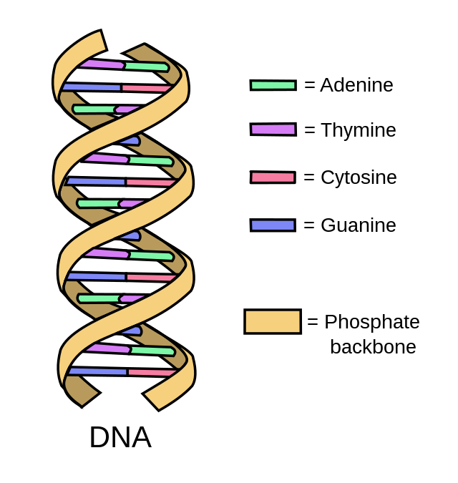
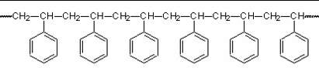
Polymer
Word:
Comes from:
Poly-
-mer
‘many’
‘units’
Definition:
A polymer is a very long molecule made up of many units.
polymer
Can you spot the repeating unit in this polymer?
monomer
Notes:
Suggested exposition:
Let’s talk about polymers. What is a polymer? A long chain molecule made of many units
The word polymer gives us a clue as to it’s meaning. The prefix ‘poly-’ means many. And the suffix ‘-mer’ means units.
So in all polymers, there are many units making a much bigger molecule. The units are called monomers, and the whole molecule is the polymer.
Let’s look back at the example you’ve seen already in biology. You have come across polymers before when studying DNA. DNA is a natural polymer.
Can you remember what the monomers are in DNA? Nucleotides
Display the white box with the question.
This is a very complex polymer called polystyrene. You don’t need to know anything about this structure until you get to A-level chemistry, however you should be able to see that it is a long chain molecule with lots of repeating units.
You should be able to see that it is a polymer.
Can you identify the monomer in this polymer? Get a student volunteer to come up and circle one repeating unit
The name of this polymer is polystyrene. The name of the monomer is styrene (without the poly in front). This is the case with many polymers, where the polymer name is the same as the monomer name, but the polymer also has a poly in front.
For example the monomer ethene. What might the polymer be called that lots of ethenes make? Polyethene
As you may have guessed, there are many many many different kinds of polymers, The properties of a polymer depends on to things:
the monomers it is made from
the conditions that the polymer is made in
Teacher guidance:
It’s helpful to use molymods here to demonstrate that
many monomers make a polymer
monomers do not always look like single atoms.
Note that it is not necessary for students to understand what the rings in the displayed formula represent, or any detail about this molecule. This question is there simple to illustrate that there are many different types of polymers, but they are all long chain molecules with repeating units. Students at this stage should just be able to spot a repeating pattern.
Image source:
CC@https://www.researchgate.net/publication/376644750_Biobased_Polylactide_Nanoparticles_as_Novel_Gene_Delivery_Nanoplatforms_Can_They_Be_Used_for_DNA_Transport
CC@https://www.flickr.com/photos/92858124@N06/8438789492

Slide 9
Representing polymers with a formula
We can represent a polymer with a displayed formula.
H H
a single line represents a single strong covalent bond
C C
The bracket and n mean that the part in the brackets is repeated n number of times
H H
n
Why don’t we just draw out the full formula every time?
H H
H H
H H
H H
C C
Many polymers are very very very long molecules which would take too long to draw
=
C C
C C
C C
H H
3
H H
H H
H H
Notes:
Suggested exposition:
Just like the displayed formulae we saw in the different types of homologous series, we can also represent polymers with a displayed formula, to show their structure.
Here is an example of a displayed formula for a polymer.
What does the C represent? A carbon atom.
So we know that this polymer contains carbon atoms
What does the H represent? A hydrogen atom
So we can see that there are several hydrogen atoms in this polymer
What do the lines represent? A strong covalent bond
Now notice that a part of this polymer formula has big brackets around it and a little ‘n’ sitting outside those brackets.
We know that polymers are very very very long molecules. So these brackets tell us that in reality if we were to look at this molecule, it would actually be longer than what we can see here. That part in the brackets represents one monomer, or one unit of the polymer. And it is repeated many many times. The number n, tells you how many times.
So if instead of an n, I had the number 100, that means that this polymer would have 100 of the part in the brackets repeating, so it is in fact a very long molecule.
Show the example on the slide where n = 3.
Here we can see an example of this. two carbons sit inside the brackets. And we can see than n=3, so this will be repeated 3 times in the main molecule.
Why don’t we just draw out the full polymer each time? Because many polymers are very long molecules, and so it would take much too long. We need a shorthand way of writing the formulae of long molecules!

Slide 10


Properties of polymers
The properties of a polymer depend on two things:
the monomers it is made from
the conditions that the polymer is made in
This means that different polymers have different uses.
LDPE: Low density poly(ethene)
HDPE: High density poly(ethene)
unreactive
flexible
can be made into a film
strong
flexible
resistant to chemicals
Notes:
Suggested exposition:
As you may have guessed, there are many many many different kinds of polymers, The properties of a polymer depends on to things:
the monomers it is made from
the conditions that the polymer is made in
This means that different polymers have different uses.
One example of this is poly(ethene).
Poly(ethene) is a polymer made from repeating units of ethene. What is ethene? An alkene, made through cracking larger alkanes.
Poly(ethene) can be made in two forms: LDPE (low density poly(ethene)) and HDPE (high density poly(ethene))
Low density polyethene is used for things like plastic bags and bubble wrap. It is unreactive and flexible.
High density poly(ethene) is used for things like pipes, big bins, buckets. It’s a harder plastic. Stronger than LDPE.
Both of these are polymers called polyethene. The monomer name is ethene. However, because these polymers are made in different conditions they have different properties.
Images from pixabay

Slide 11
Thermosoftening and Thermosetting plastics
We can put plastics (polymers) into 2 categories depending on how they respond to heating:
Thermosoftening polymers melt when heated.
Thermosetting polymers do not melt when heated.
What is the difference in structure?
Notes:
Suggested exposition:
We can put plastics into two categories, generally. If the plastic melts when heated we say it is thermosoftening. Lets look at that word – ‘Thermo-’ What does that prefix mean? Something to do with heat – think of a thermometer, thermos flask, etc.
‘softening’ indicates getting softer.
So, Thermosoftening plastics get softer when heated.
Show students a plastic object that would melt when heated – a pen, a plastic bottle, for example. Do you think this is a thermosftening plastic? Yes, because it would melt when I heat it.
Note: do not demonstrate the melting of plastic as this can release toxic fumes.
Looking at the diagram that represents these polymers, you can see the polymer chains here clearly, made of many monomers, linked together with covalent bonds. But the chains are not linked together with covalent bonds, which means its easier to separate these molecules with little energy, and so it melts easily. They have intermolecular forces between chains, but these do not require much energy to overcome.
Thermosoftening polymers represent most of the plastics we use everyday. Because they can be melted, they can be recycled (this process involves melting the plastic).
The other type of plastic is thermosetting plastic. These do not melt when heated. Let’s look at the structure. What’s the difference? There are covalent bonds joining the polymer chains. These are called crosslinks.
These polymers don’t melt when heated. They will burn, but are much more resistant to heat than the thermosoftening plastics. For this reason they are used for things like electrical plug casings which will not melt if the wiring inside gets very hot.
Both of these plastics are made of polymer chains as you can see from the diagrams. Point out the polymer chains in both diagrams.
There are relatively strong intermolecular forces holding these chains together, which is why most polymers are solid at room temperature.
Additional information for teachers:
The yellow band on the introduction slides indicates that this is a separate science topic.

Slide 12

Can you explain the difference between these two terms?
Covalent bonds
Where is each found?
Are they weak or strong?
How much energy is needed to overcome each?
Where are they found in thermosoftening polymers?
Where are they found in thermosetting polymers?
Intermolecular forces
Notes:
Suggested points:
Covalent bonds are intramolecular bonds, found within molecules. They are very strong and require a lot of energy to overcome.
Intermolecular forces are weak forces found between molecules, they do not need much energy to overcome.
Thermosoftening polymers contain strong covalent bonds within the molecules and weak intermolecular forces between molecules.
Thermosetting polymers contain strong covalent bonds within the molecules plus crosslinks, which are covalent bonds between molecules.
Suggested guidance:
Talk tasks can be used in a variety of ways to suit the particular needs of the students you are teaching. Through exchanging views with others, students develop their understanding of the science beyond what could be achieved individually.
Science classrooms that successfully integrate talk have the following features:
Science talk is a regular feature of lessons and is woven into classroom activities.
Students are paired or grouped strategically by the teacher to ensure productive interaction. This might take into consideration the students’ proficiency of the English language, how encouraging they might be to peers and their attainment in the topic. It’s a good idea to consider these pairings in the class seating plan.
Students are encouraged and supported to talk, but are not forced to talk.
The teacher should take on the role of a facilitator, engaging with conversations where necessary and encouraging or steering the conversation where needed.
Students are encouraged to use the language they have to express their ideas (e.g., everyday language, imperfect English, native language), but also to incorporate science specific terminology where this is more accurate or has been taught.
6. Scientifically inaccurate ideas are not dismissed by the partner or teacher; open discussion and further investigation are relied on to help students construct ideas that support them to progress in their scientific understanding.
7. Guidelines for behaviour during talk tasks are explicit and frequently reviewed. Rules for students might be:
Listen carefully to your partner
Take turns talking.
Speak one at a time, without interrupting.
Politely agree or disagree and explain why.
Politely point out if your partner has used a scientific word incorrectly, if they have explained the science incorrectly, or if there is a more accurate way to describe something.
If confused, ask questions.
Stay focused on the discussion topic.
Respond to one another.

Slide 13
What does the displayed formula below represent?
H H
What does this show the formula for?
How many repeating units are in the polymer molecule?
How many carbon atoms are in the polymer molecule?
How many hydrogen atoms are in the polymer molecule?
What is represented by each straight line?
A repeating unit of a polymer
C C
36
H H
n
72
144
A covalent bond
Notes:
Note: in this lesson, students are only expected to be able to represent the repeating units, not the original monomers. That is only required for separate science, so is covered in the next lesson.

Slide 14
Drill
What is a polymer?
What kind of bonding occurs between monomers in a polymer?
What does the n represent in the general formula for a polymer?
Name the forces that act between the polymer molecules.
State whether these forces are weak or strong
Describe the state of polymers at room temperature
What determines the properties of polymers?
Chemistry only
What happens to thermosetting polymers when heated?
What happens to thermosoftening polymers when heated?
Explain why these polymers behave differently when heated.
Notes:
Purpose: This is a knowledge drill. The purpose of this is to check that the critical knowledge is secure before pupils move onto independent practice.
Suggested guidance: There are a range of ways this could be done depending on time and ability range of the class:
Mini whiteboards
As full sentences in exercise books
As short answers in exercise books
In the pupil workbook
As pair talk
As cold call

Slide 15
Drill answers
Long chain molecules made of many units
Covalent bonding
n represents the number of repeating units of the polymer
Intermolecular forces act between the polymer molecules
These forces are relatively strong
Polymers are solids at room temperature
The properties of polymers are determined by the monomers that make them up and the conditions that they are made in.
Thermosetting polymers do not melt when heated.
Thermosoftening polymers melt when heated.
Thermosetting polymers contain crosslinks, which are covalent bonds between molecules. These require much more energy to overcome, so they have much higher melting points.
Notes:
Purpose: This is a knowledge drill. The purpose of this is to check that the critical knowledge is secure before pupils move onto independent practice.
Suggested guidance: There are a range of ways this could be done depending on time and ability range of the class:
Mini whiteboards
As full sentences in exercise books
As short answers in exercise books
In the pupil workbook
As pair talk
As cold call

Slide 16
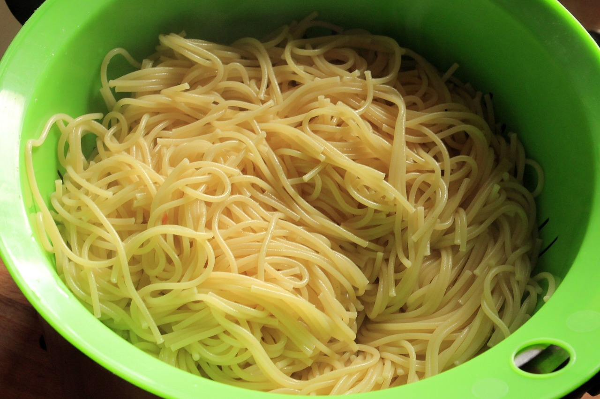

I: Explain: to use scientific understanding to make something clear or state the reason for something happening
Example question:
To ‘explain’ your answer should:
Begin with a scientific statement.
Use ‘this means that’, ‘because’ or ‘so’ to link your statement to the question.
Explain how the properties of a thermosetting polymer makes it useful for a pasta drainer.
Model answer:
Thermosetting polymers contain crosslinks, which are covalent bonds between molecules
These require a lot of energy to overcome, so thermosetting polymers have high melting points and do not melt when heated
This means they will not melt when hot food is placed in them
Notes:
This slide models the process of answering an explain question.
Firstly, students are presented with a generic explain question, along with a model answer. Students are also given some simple guidance to follow for producing their own describe answer.
The generic question and answer should be used by the teacher to remind students of
the key features of a great answer
how to structure their answer
why the model answer is a good example
Following this, students will be required to apply this process to answer their own explain question, which will appear in place of the generic questions. This explain question will be specific to the topic students are learning about in the lesson. Give students time to write their own answer to this, ensuring that they use the guidance provided. To further scaffold this task for students, it may be appropriate to:
pair students up to write an answer together
list for students the key words you would like them to include in the answer
provide a writing frame or ‘points to include’ for students
A model answer for this question will appear. Teachers should review the model answer with students by referencing the guidance in the green box. For example ‘we can see item 1 in the guidance is to begin with a scientific statement. Notice in the model answer here we have done just that’. Or ‘item 2 in the guidance here says that we should use a linking statement in the answer. Has this been achieved in the model answer? Where can we see this?’.
Image from pixabay

Slide 17
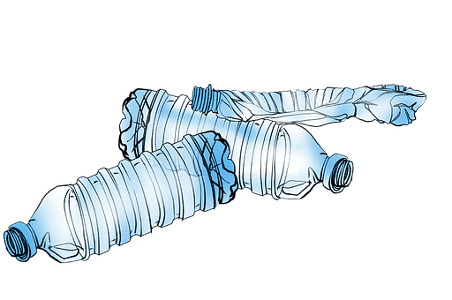
We: Explain: to use scientific understanding to make something clear or state the reason for something happening
Example question:
To ‘explain’ your answer should:
Begin with a scientific statement.
Use ‘this means that’, ‘because’ or ‘so’ to link your statement to the question.
Many recyclable plastic bottles are made from thermosoftening polymers.
Explain how the properties of a thermosoftening polymer make them suitable for recycling.
Model answer:
Thermosoftening polymers contain weak intermolecular forces between molecules
These do not require a lot of energy to overcome, so thermosoftening polymers have low melting points and melt when heated
This means they can be melted and reshaped to be recycled into other products
Notes:
This slide models the process of answering an explain question.
Firstly, students are presented with a generic explain question, along with a model answer. Students are also given some simple guidance to follow for producing their own describe answer.
The generic question and answer should be used by the teacher to remind students of
the key features of a great answer
how to structure their answer
why the model answer is a good example
Following this, students will be required to apply this process to answer their own explain question, which will appear in place of the generic questions. This explain question will be specific to the topic students are learning about in the lesson. Give students time to write their own answer to this, ensuring that they use the guidance provided. To further scaffold this task for students, it may be appropriate to:
pair students up to write an answer together
list for students the key words you would like them to include in the answer
provide a writing frame or ‘points to include’ for students
A model answer for this question will appear. Teachers should review the model answer with students by referencing the guidance in the green box. For example ‘we can see item 1 in the guidance is to begin with a scientific statement. Notice in the model answer here we have done just that’. Or ‘item 2 in the guidance here says that we should use a linking statement in the answer. Has this been achieved in the model answer? Where can we see this?’.
Image from pixabay

Slide 18
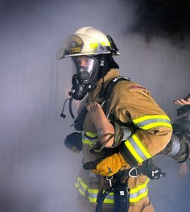
You: Explain: to use scientific understanding to make something clear or state the reason for something happening
Example question:
To ‘explain’ your answer should:
Begin with a scientific statement.
Use ‘this means that’, ‘because’ or ‘so’ to link your statement to the question.
Firefighters’ helmets are made from thermosetting polymers.
Explain how the properties of a thermosetting polymer make them suitable for this purpose.
Model answer:
Thermosetting polymers contain crosslinks, which are covalent bonds between molecules
These require a lot of energy to overcome, so thermosetting polymers have high melting points and do not melt when heated
This means they will not melt when exposed to high temperatures
Notes:
This slide models the process of answering an explain question.
Firstly, students are presented with a generic explain question, along with a model answer. Students are also given some simple guidance to follow for producing their own describe answer.
The generic question and answer should be used by the teacher to remind students of
the key features of a great answer
how to structure their answer
why the model answer is a good example
Following this, students will be required to apply this process to answer their own explain question, which will appear in place of the generic questions. This explain question will be specific to the topic students are learning about in the lesson. Give students time to write their own answer to this, ensuring that they use the guidance provided. To further scaffold this task for students, it may be appropriate to:
pair students up to write an answer together
list for students the key words you would like them to include in the answer
provide a writing frame or ‘points to include’ for students
A model answer for this question will appear. Teachers should review the model answer with students by referencing the guidance in the green box. For example ‘we can see item 1 in the guidance is to begin with a scientific statement. Notice in the model answer here we have done just that’. Or ‘item 2 in the guidance here says that we should use a linking statement in the answer. Has this been achieved in the model answer? Where can we see this?’.
Image from pixabay

Slide 19
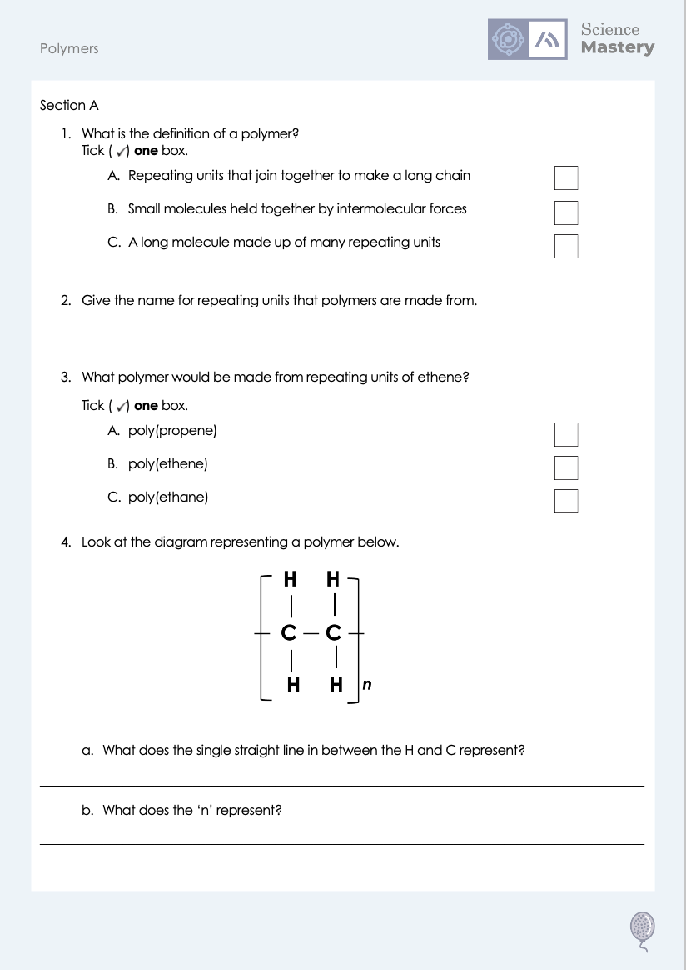
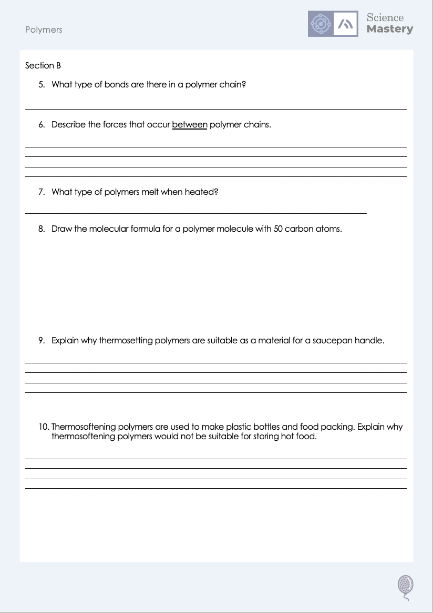
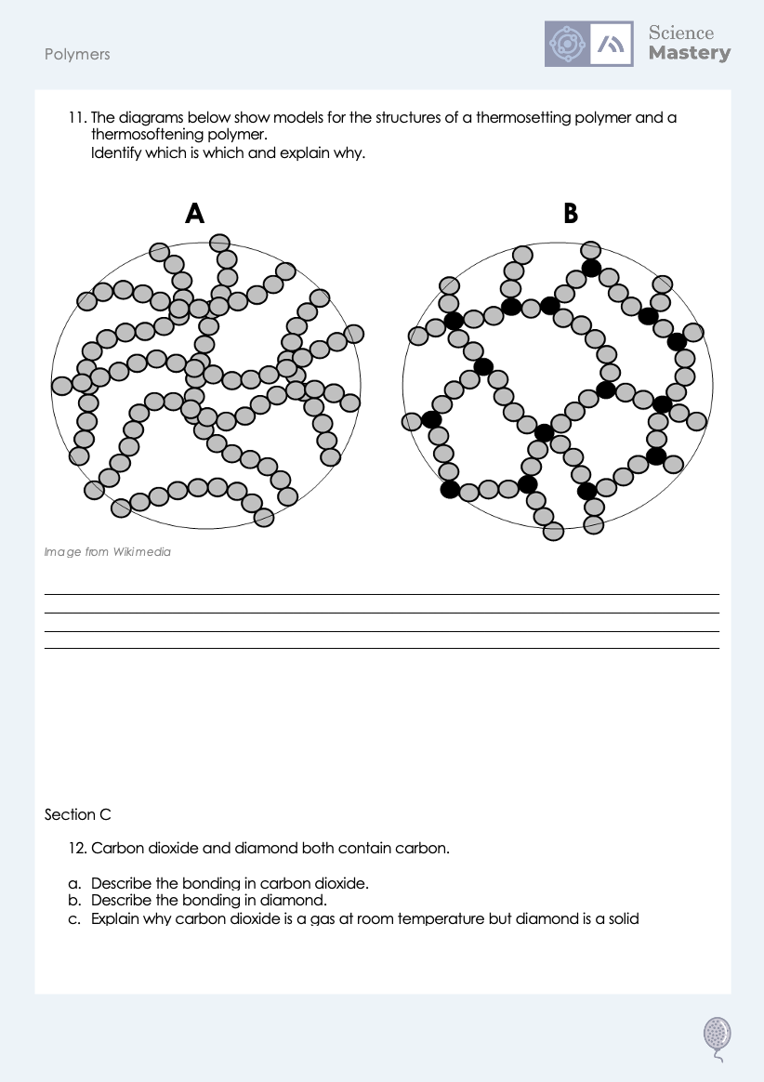
Worksheet

Slide 20
Answers
1. C - A long molecule made up of many repeating units
2. Monomer(s)
3. B - poly(ethene)
4a. A covalent bond
4b. The number of repeating units in the polymer molecule

Slide 21
Answers
5. Covalent
6. There are (weak) intermolecular forces between polymer chains.
7. Thermosoftening polymers
8.
H H
C C
H H
25

Slide 22
Answers
9. Thermosetting polymers do not melt when they are heated, so when the saucepan heats up the handle would not melt.
10. Thermosoftening polymers melt when they are heated, so if hot food was placed in them, they would melt.
11. A is thermosoftening, B is thermosetting
B contains crosslinks, which are covalent bonds between the polymer chains

Slide 23
Answers
12a. In carbon dioxide, there is one carbon atom that makes two covalent bonds (a double bond) with each oxygen atom, sharing electrons so that all atoms have a full outer shell.
12b. In diamond, each carbon atom is covalently bonded to four other carbon atoms in a giant covalent network.
12c. There are weak intermolecular forces between molecules of carbon dioxide, which can be easily overcome, so it has a low melting and boiling point.
A great deal of energy would be needed to overcome the many strong covalent bonds in diamond, so it has a very high melting and boiling point.

Slide 24
Answer the questions below.
How many carbon atoms will the polymer represented by this diagram have?
A. 20
B. 40
C. 80
H H
C C
✓
H H
20
What is between polymer molecules?
A. Covalent bonds
B. Intermolecular forces
C. Electrostatic attraction
✓
What is the difference between thermosetting and thermosoftening polymers?
A. Thermosoftening polymers melt when heated
B. Thermosetting polymers melt when heated
C. Thermosoftening polymers contain crosslinks
✓
Notes:
Q1. Answer: B
If students answer A, they have accepted the number ‘n’ as equalling the number of carbon atoms, and disregarded the number of carbons within the brackets. If students answered C, they have calculated the number of hydrogens in the molecule instead. To fix-it, model the correct method of carrying out this calculation and then give students some similar questions to try independently.
Q2. Answer: B
If students answer A, they have made the common mistake of confusing the bonds within molecules with the IMFs between them. If students answer C, they have confused covalent and ionic bonding. To fix it, review the different types of bonding and why covalent molecules have relatively low melting and boiling points but polymers have higher melting and boiling points.
Q3. Answer: A
If students answer B or C, they are not clear on the difference between thermosetting or thermosoftening polymers. To fix it, review the structure of each and how this affects their properties.

Slide 25
Lesson C5.1.12
What was good about this lesson? | What can we do to improve this lesson?
Send us your feedback by clicking this link
or by emailing sciencemastery@arkonline.org
Thank you!

